Slide 1
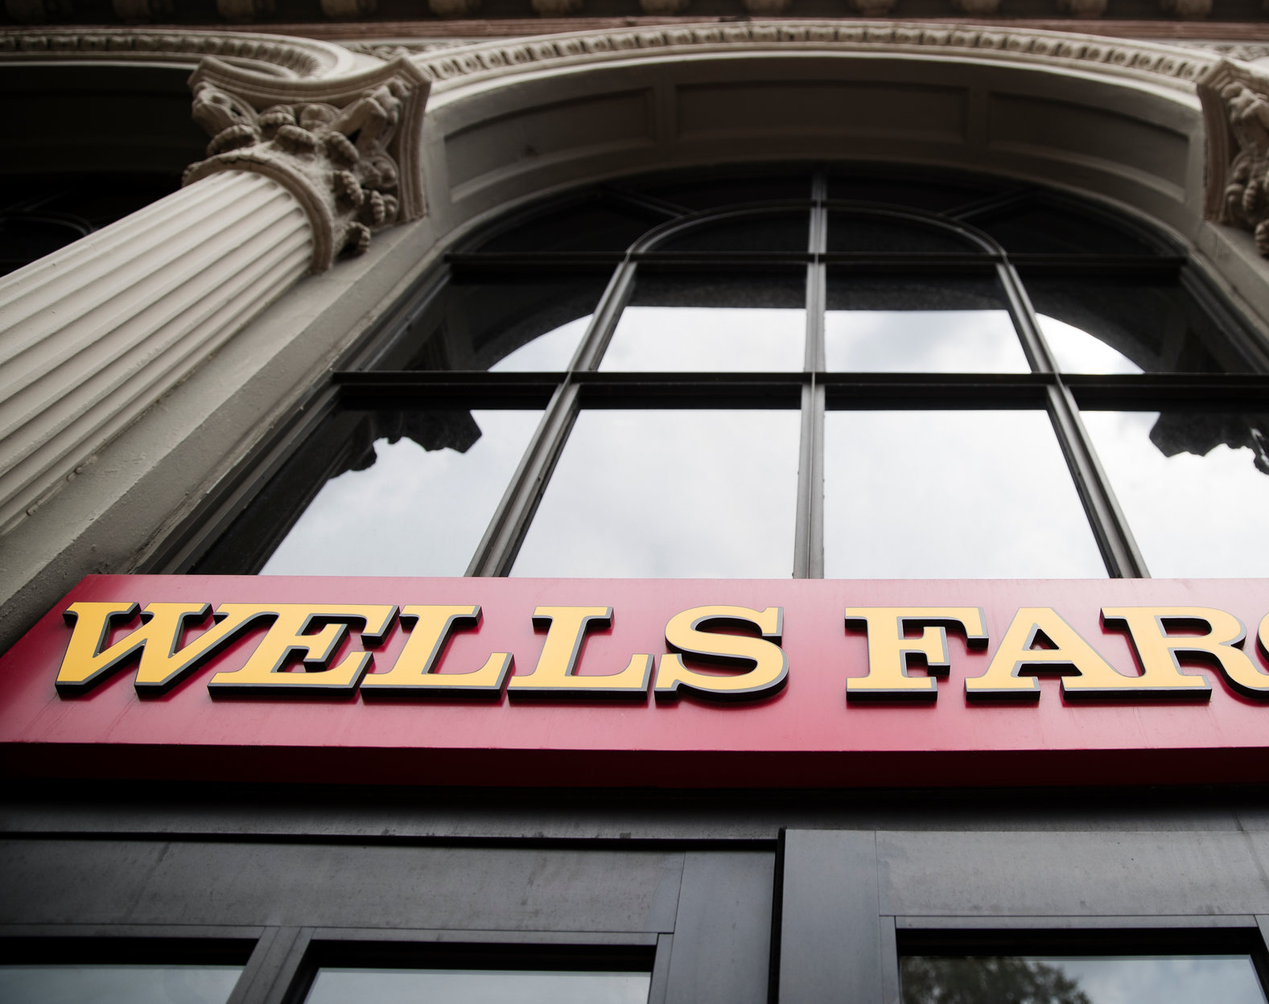
Wells Fargo Misconduct
Group Members:
Rakshita Singh (A2305219691)
Mitashi Bansal (A2305219684)
Devangna Jain (A2305219647)

Slide 2
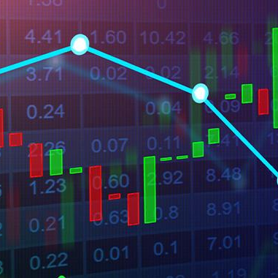
Contents:
In today’s presentation we will be discussing about Wells Fargo fraud - American financial institution – 2011-2015
Secondly, we will be discussing about what are the ethical violations that took place.
In addition, we will be discussing about what were the key remedial measures that have been implemented to curb its effect.
Furthermore, we will be knowing about impact of the fraud on various parts of society
Last but not the least we will be explaining what happened in this fraud exactly through a short illustrative video.
This Photo by Unknown Author is licensed under CC BY-NC

Slide 3
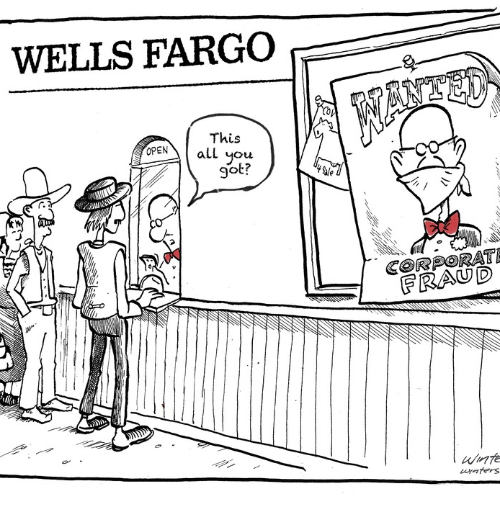
Introduction:
Wells Fargo provides banking, investment and mortgage products and services, as well as consumer and commercial finance to more than 7,200 locations, more than 13,000 ATMs, the internet, and mobile banking and has offices in 31 countries.
It stands on Three pillars:
Relationships that last a lifetime
Expertise and guidance to help customers make confident decisions
Going the extra mile to do what’s right

Slide 4
In 2013, rumors circulated that Wells Fargo employees in Southern California were engaging in aggressive tactics to meet their daily cross-selling targets. According to the Los Angeles Times, approximately 30 employees were fired for opening new accounts and issuing debit or credit cards without customer knowledge, in some cases by forging signatures.
In September 2016, Wells Fargo announced that it would pay $185 million to settle a lawsuit filed by regulators and the city and county of Los Angeles, admitting that employees had opened as many as 2 million accounts without customer authorization over a five-year period.

Slide 5
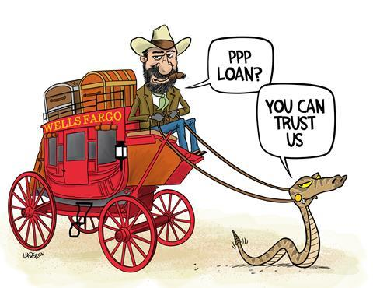

Ethical Violations :
(something that is - spoken, written, actioned - that violates a company's documented code of ethics, mission, vision, values, and culture)
A misalignment between stated and actual organizational vision and values
Conflicts of Interest
Violation of Beneficence
Lack of Fidelity “ Trust Issues “.
Those who tried to warn senior managers of these violations were often ignored
Unfair treatment to the customers

Slide 6

Key Remedial Measures Implemented:
Replacement and reorganization of leadership
Elimination of sales goals
Improving incentive and performance management systems
Centralizing control functions
New policy for Ethics, Oversight, and Integrity

Slide 7
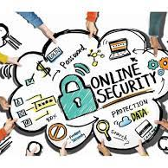
Impact of the fraud:
EFFECT ON SERVICES
Many organizations, including government entities, have suspended their ties with Wells Fargo over the recent scandal. This also means that if you are a financial advisor who is currently working with or for Wells Fargo, your business will be directly impacted.
EFFECT ON FINANCIAL UNCERTAINTY
This cost Wells Fargo millions of dollars in fines and refunds to clients. Furthermore, profit expectations and share prices have fallen
EFFECT ON REPUTATION
Investors do not trust Well Fargo Advisors due to the scandal. They “Re-Established" to emphasize the company's commitment

Slide 8

What actually happened in the Fraud!!!

Slide 9

THANK YOU

